Slide 1

Interpolation and Curve Fitting
Pierre Bézier
De Casteljau construction of Bezier curve
From www.wikipedia.org
Notes:
Pierre Étienne Bézier (September 1, 1910 – November 25, 1999) (pronounced "bay zee ay“)
Received his Ph.D. in mathematics at age 67, (1977)

Slide 2
Outline
Overview of interpolation problem
Polynomial interpolation
Bezier curves and b-splines
Least square approximation
Robust curve fitting

Slide 3
Interpolation
Basic problem: for given data
with x₁ < x₂ < … < x_{m} determine function f : such that
f is interpolating function, or interpolant, for given data

Slide 4
Interpolation (cont.)
Additional data might be specified, such as slope of interpolation function at given points
Additional constraints might be imposed, such as smoothness, monotonicity, or convexity of interpolation function
f could be function of more than one variable

Slide 5
Purposes of Interpolation
Plotting smooth curve through discrete data points
Reading between lines of table
Differentiating or integrating tabular data
Replacing complicated function by simple one

Slide 6
Interpolation vs Approximation
Interpolation function fits given data points exactly
Interpolation is inappropriate if data points subject to significant errors
Approximation is usually preferable for smoothing noisy data

Slide 7
Issues in Interpolation
There are arbitrarily many functions interpolating given data points
What form should function have?
How should function behave between data points
Should function inherit properties of data, such as montonicity, convexity, or periodicity?
Are parameters that define interpolating function meaningful?

Slide 8
Choosing Interpolant
Choose function for interpolation based on
How easy function is to work with
determining its parameters
evaluating function
differentiating or integrating function
How well properties of function match properties of data to be fit (smoothness, monotonicity, convexity, periodicity, etc.)

Slide 9
Functions for Interpolation
Families of functions commonly used for interpolation include
Polynomials
Piecewise polynomials
Trigonometric functions
Exponential functions
Rational functions
We will focus on interpolation by polynomial and piecewise polynomials for now

Slide 10
Polynomial Interpolation
Simplest type of interpolation
Unique polynomial of degree at most n-1 passes through n data points (x_{i}, y_{i}), i = 1, …, n, where x_{i} are distinct
There are many ways to represent or compute polynomial, but in theory all must give the same result

Slide 11
Lagrangian Polynomials
For a cubic polynomial case,

Slide 12
Error of Polynomial Interpolation
The error term of polynomial interpolation can be expressed as
Not very useful for computing real error as f is usually unknown
Good for interpretation of some effects in error analysis

Slide 13
Proof
Let
Define an auxiliary function
W(t) has n+2 zeros, x₀, x₁, …, x_{n}, and x
W’(t) has n+1 zeros if W is a C¹ function
W”(t) has n zeros if W is a C² function
and so on…..
W^{(n+1)}(t) has at least one zero

Slide 14
Side Note: Mean Value Theorem (MVT)
W(t) has n+2 zeros, x₀, x₁, …, x_{n}, and x
W’(t) has n+1 zeros, between each of x₀, x₁, …, x_{n}, and x
W’(t)=0
x_{i}
x_{i+1}

Slide 15
Proof (cont.)
Polynomial of degree n

Slide 16
Interpretation of Error Term
Interpolation works better for x within x_{i}‘s
Error is smaller if x is centered within x_{i}
“Interpolation” outside (x₀ ,x_{n}), called extrapolation, will have large errors than interpolation

Slide 17
Disadvantages of Polynomial Interpolation
Need to re-compute the interpolation function if adding or removing a data point
Divided-differences method avoids this problem using fewer arithmetic operations
Divided-differences gives the same polynomial as Lagrangian interpolation

Slide 18
Divided Differences
Given data points (x_{i}, y_{i}), i = 0,…,n, divided differences, denoted by f[], defined recursively by
Some examples:

Slide 19
Divided differences (cont.)
Let
then
Let
then

Slide 20
Divided differences (cont.)
Let
then

Slide 21
Divided differences (cont.)
One can show in similar fashion that P_{n}(x_{i}) = f_{i} if a_{i} = f[x₀, x₁, …, x_{i}]
We can then rewrite

Slide 22
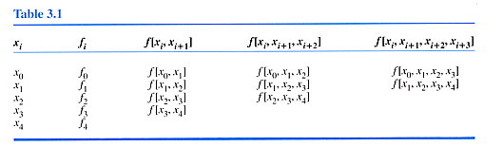
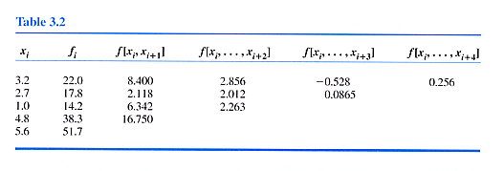
Example: Divided Differences

Slide 23
Example: Divided Differences (cont.)

Slide 24
Example: Divided Differences (cont.)
If only the first four points are used,

Slide 25
Example: Divided Differences (cont.)
If the 5th point is added

Slide 26
Identical Polynomials
Every polynomial of degree n that has the same value at n+1 distinct points is exactly the same
Proof by contradiction
Suppose there are two different polynomials
Their difference D(x) = P_{n}(x) – Q_{n}(x) is a polynomial of at most degree n
P and Q match at all n+1 points→ D(x) = 0 at these n+1 points, i.e., D(x) has n+1 distinct zeros
However, D(x) is of at most degree n → n zeros at most
Contradicts!
Notes:
D(x) cannot have both n+1 and n distinct zeros! This is a contradiction, so Pn(x) = Qn(x)
D(x) should be identically zero

Slide 27
Different Forms of Polynomial Interpolation
Polynomials of degree n that interpolate n+1 data points are identical
Their error terms are also identical
Only need to derive the error term for one form of interpolating polynomial

Slide 28
Error Estimation When f(x) is unknown—The Next Term Rule
The nth order divided difference is an approximation for f^{(n)}(x)/n!
It can be shown in Chap 5 that
E_{n}(x) = the value of the next term that would be added to P_{n}(x)

Slide 29
Function Differences Method
If x-values of data points are evenly spaced, divided differences method can be expressed as

Slide 30
Definition of Function Differences
First-order differences
Second-order differences
nth-order differences
Binomial coefficients

Slide 32
Function Differences (cont.)

Slide 33
Function Differences (cont.)

Slide 34
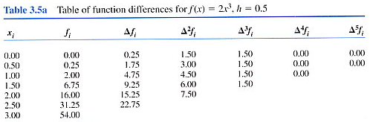
Example: Function Difference

